Slide 1
Realistically Bad Data
Liam Boone
September 29th, 2014

Slide 2
About Me
Pennsylvania State University (2007 – 2012)
B.S. in Electrical Engineering
B.S. in Computer Engineering
University of Pennsylvania (2012 – 2014)
M.S.E. in Computer & Information Science
Sandia National Labs (2012 – Now)

Slide 3
My History with CIS 565

Slide 4
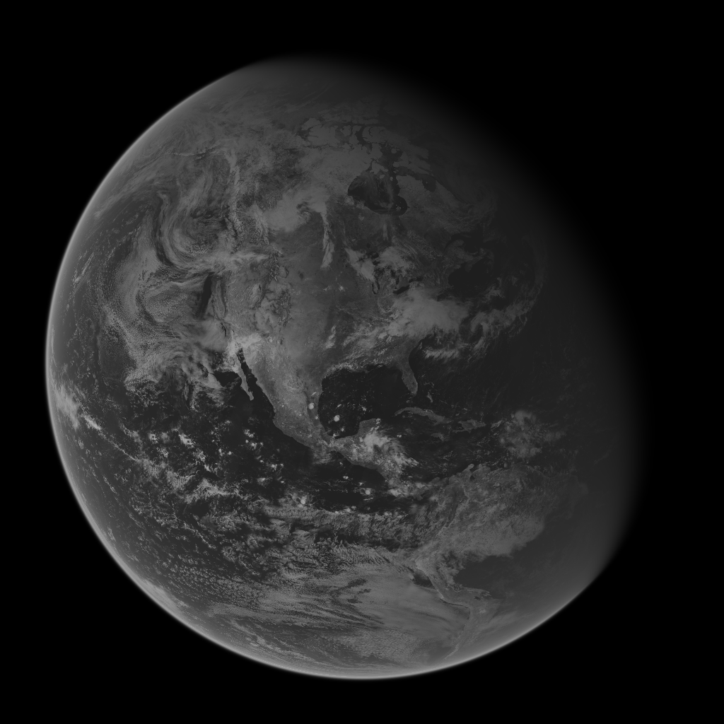

Globe Rendering
All world and cloud textures courtesy of NASA’s MODIS datasets

Slide 5
Motivation
Strong need for payload agnostic simulation of real-time data
Introduce more dynamic scene elements to allow greater flexibility for algorithm developers
Current test data has static backgrounds and little to no bad pixels
Would allow developers to test on realistic scenes
Goals:
Faster development cycles and fewer bugs in software
Dynamically produce realistic scenes to provide developers with a larger library of test scenarios

Slide 6
Processing Flow
Generate Rays for Each Pixel
Intersect Rays with Earth Model
Calculate Intensities

Slide 7

Generate Rays
Rays form a one-to-one correspondence with Pixels in the simulated focal plane
Each Ray originates at the center of an idealized camera located at some position in space and extends through an imaginary focal plane located some distance in front of the idealized camera
For this we need to know:
Position of the camera
Rotation of the camera (to determine where it is looking)
Resolution of the focal plane (number of pixels wide/tall)
Field of view of the camera
Rays
Focal Point
Focal plane
Field of View
Earth

Slide 8
Sensor Jitter
The camera is not perfect and will move from frame to frame
Represented as a rotation from true pointing direction
Euler angles (Roll, Pitch, Yaw)
Very small
Random values sampled from N-D Gaussian distribution
Over time the look angle will walk off from where it should be
Roll
Yaw
Pitch

Slide 9
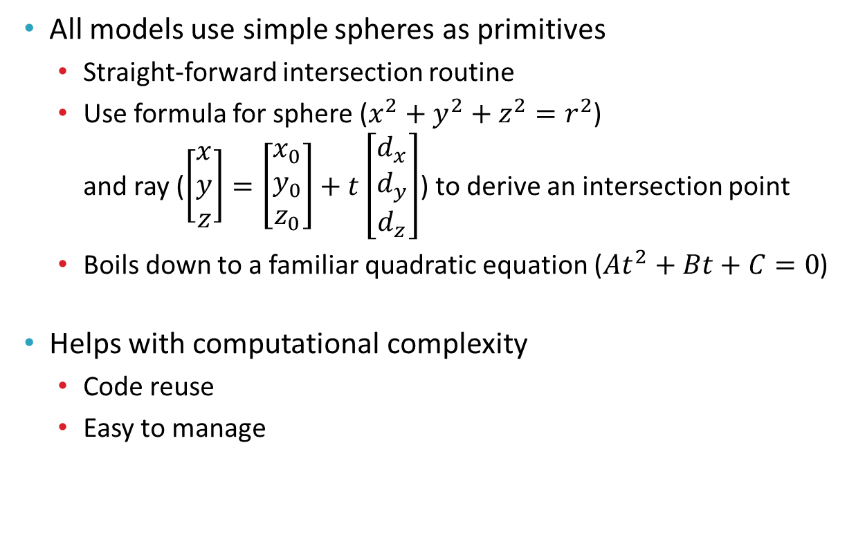
Ray Intersection
All models use simple spheres as primitives
Straight-forward intersection routine
Use formula for sphere ($x^{2}+y^{2}+z^{2}=r^{2}$) and ray ($\left[\begin{aligned}x \\ y \\ z\end{aligned}\right]=\left[\begin{aligned}x_{0} \\ y_{0} \\ z_{0}\end{aligned}\right]+t\left[\begin{aligned}d_{x} \\ d_{y} \\ d_{z}\end{aligned}\right]$) to derive an intersection point
Boils down to a familiar quadratic equation ($At^{2}+Bt+C=0$)
Helps with computational complexity
Code reuse
Easy to manage

Slide 10

Earth Model (Simple)
Simple Earth Model
Two concentric spheres
Inner sphere represents the surface of the earth
Outer sphere is the cloud layer
Details are represented by textures
No height data involved
Intensity values from NASA MODIS
Clouds are “flattened” into one layer
Pros
Easy to code
Fast
Clouds
Earth
Cons
Not very realistic
Some test cases hard to represent

Slide 11
Earth Model (Complex)
Complex Earth Model
Three concentric spheres
Inner two spheres as before
Outer sphere is the extent of the atmosphere
Atmosphere layer contributes scattering
Rayleigh and Mie scattering
Must evaluate a double integral per pixel
Wavelength dependent
Pros
More accuracy
More test cases
Atmosphere
Clouds
Earth
Cons
Still not perfect
Requires much more computation

Slide 12
Intensity calculation
Terrain Reflectance
Cloud Obscuration
Atmospheric Attenuation
Noise

Slide 13
Terrain
From the ray/sphere intersection point determine a Lat/Lon coordinate
Sample from an image representing the surface of the earth to get the base intensity
Sample from a binary image representing whether a given coordinate is water or not to get the specular coefficient
Use simple Phong lighting model to apply diffuse and specular components of the sun’s light

Slide 14


Clouds
From the ray/sphere intersection point determine a lookup coordinate
Sample the cloud image to determine a cloud density value
Use the density value to attenuate the intensity of the ground
Can also use a second ray cast to the sun to determine if the clouds will cast a shadow on the surface of the earth

Slide 15

Atmosphere I
Attenuation based on distance light travels through the atmosphere
Calculated with a double integral
Attenuation Factor:
$$K\left(λ\right)=\frac{K_{0}}{λ^{4}}$$
Phase Function:
$$F\left(θ,g\right)=\frac{3(1−g^{2})(1+\cos^{2}θ)}{2(2+g^{2}){(1+g^{2}+2g cosθ)}^{\frac{3}{2}}}$$
Out-Scattering Function:
$$t\left(P_{a},P_{b},λ\right)=4πK\left(λ\right)\int_{P_{a}}^{P_{b}}{e^{−\frac{h}{H_{0}}}}ds$$
In-Scattering Function:
$$I_{v}\left(λ\right)=I_{s}\left(λ\right)K\left(λ\right)F\left(θ,g\right)\int_{P_{a}}^{P_{b}}{e^{−\frac{h\left(−t\left(P,P_{c},λ\right)−t\left(P,P_{a},λ\right)\right)}{H_{0}}}ds}$$

Slide 16
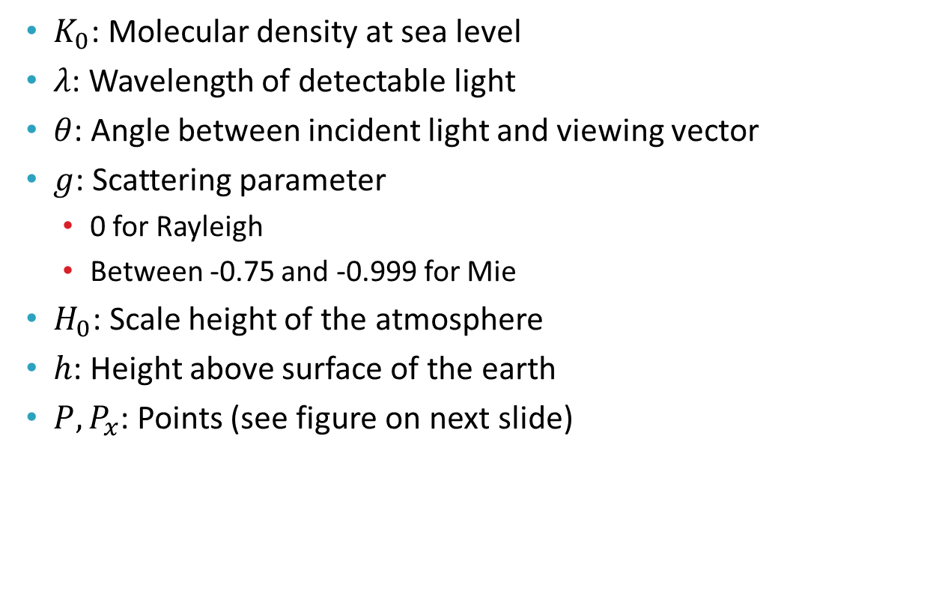
Atmosphere II
$K_{0}$: Molecular density at sea level
$λ$: Wavelength of detectable light
$θ$: Angle between incident light and viewing vector
$g$: Scattering parameter
0 for Rayleigh
Between -0.75 and -0.999 for Mie
$H_{0}$: Scale height of the atmosphere
$h$: Height above surface of the earth
$P,P_{x}$: Points (see figure on next slide)

Slide 17




Atmosphere III
$$P_{c}$$
$$P_{b}$$
$$P_{a}$$
$$P$$

Slide 18
Scattering Results
All world and cloud textures courtesy of NASA’s MODIS datasets

Slide 19
Intensity Calculation (Noise)
Shot noise
Simulates a more grainy image
Use a Poisson distribution centered on the pixel value
Variable with time
Popcorn noise
Simulates under/over-excited pixels
Sample a uniform distribution and saturate or zero the pixel if the sample is above or below some threshold respectively
Variable with time
Fixed pattern noise
Simplest noise type
Defines a fixed pattern of dead/under-excitable pixels
Constant over the lifetime of the simulation

Slide 20
Shot Noise
Knuth’s Poisson sampling algorithm:
Can be parameterized by multiplying λ by some constant s before sampling and then dividing by the same constant afterwards
Small values of s lead to more grainy images
Large values of s cause the algorithm to perform slower
Def Poisson(λ):
Let L ← exp(−λ), k ← 0 and p ← 1.
do:
k ← k + 1.
Generate uniform random number u in [0,1].
let p ← p × u.
while p > L.
return k − 1.
Poisson(λ*s)/s

Slide 21

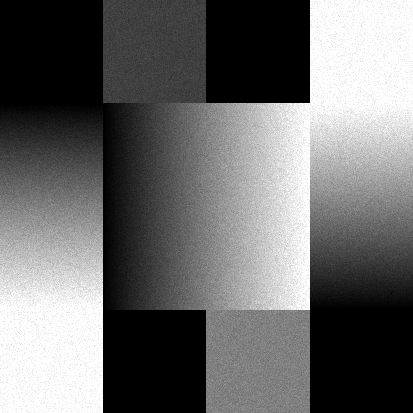
Shot Noise
Test Pattern
Noise (s=2)

Slide 22
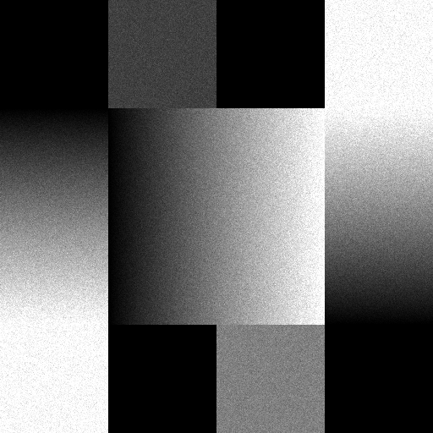
Shot Noise
Test Pattern
Noise (s=1)

Slide 23
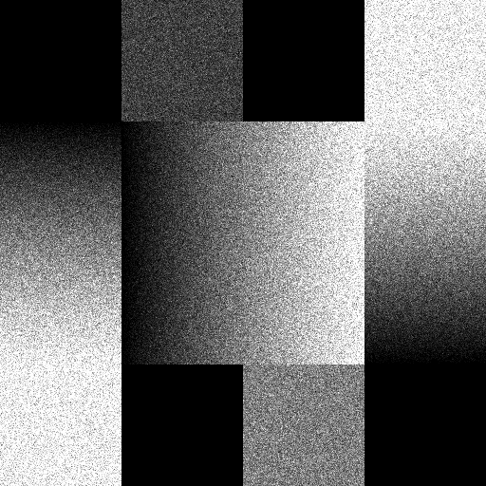
Shot Noise
Test Pattern
Noise (s=0.1)

Slide 24
Popcorn Noise
Popcorn sampling algorithm:
Def Popcorn(x, t):
Generate uniform random number u in [0,1].
If u > (1-t):
return 255.
If u < t:
return 0.
return x.

Slide 25
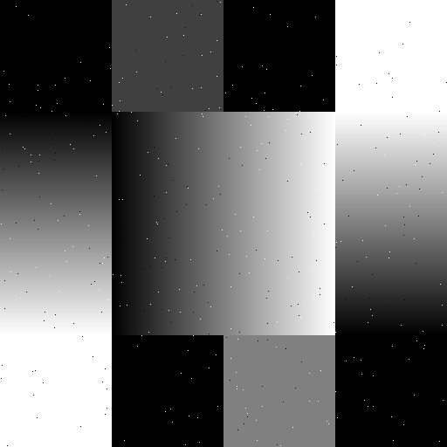
Popcorn Noise
Test Pattern
Noise (t=0.001)

Slide 26
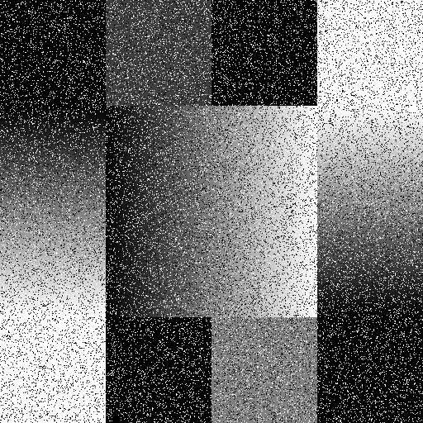
Popcorn Noise
Test Pattern
Noise (t=0.1)

Slide 27
Fixed Pattern Noise
Fixed pattern noise is simply a constant offset or attenuation applied to the whole FPA
Simulates manufacturing defects and errors present in the hardware

Slide 28
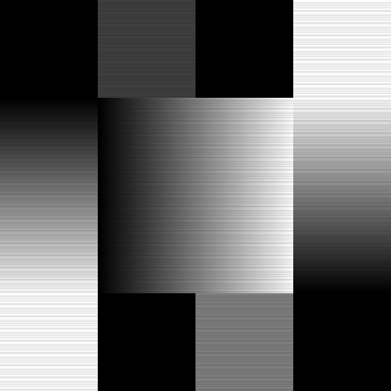
Fixed Pattern Noise
Test Pattern
Noise (Horizontal Bars)

Slide 29
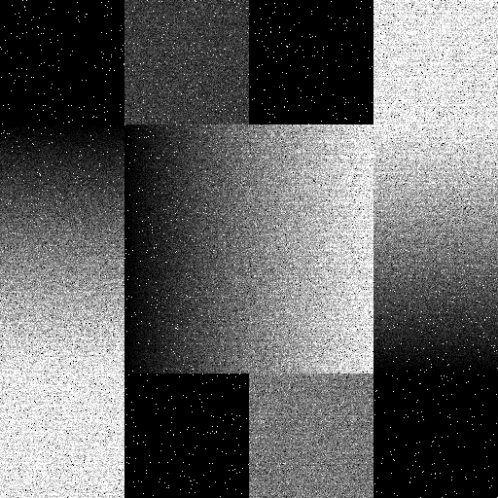
All Together
Test Pattern
Noise (p=0.1, t = 0.01, Bars)

Slide 30
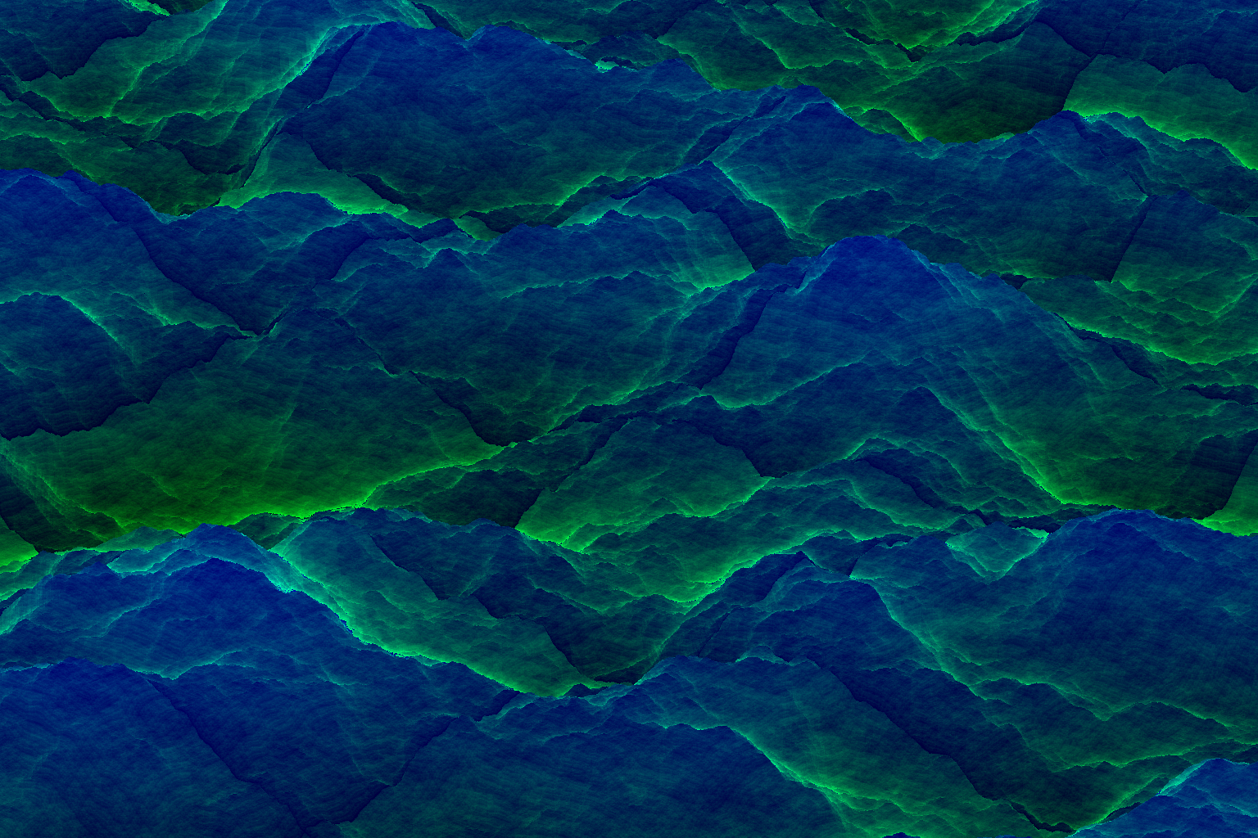
Terrain Rendering

Slide 31
Overview
Atmospherics and sensor noise are great first steps
Good enough for some situations
Sometimes necessary to fully model the terrain
Need terrain data to answer questions about where mountain shadows lie
Is a particular asset’s view obstructed by terrain in any way?
Current dataset chosen is DTED level 1
Partial global coverage
90m post spacing in most of the world

Slide 32
Algorithm
Preprocess data into a chunked maximum mipmap format
Each entry in each level of the mipmap represents the maximum height of the four entries in the next finer level
A 513x513 chunk of elevation posts give a 512x512 initial level
Generate coarser levels until one value is reached
Chunk edges will share posts
Ray march through the mipmap structure
Step through progressively finer levels of the mipmap until the finest layer is encountered or the ray steps off of the chunk
Intersect the ray with a bilinear patch to determine the final elevation of the terrain

Slide 33

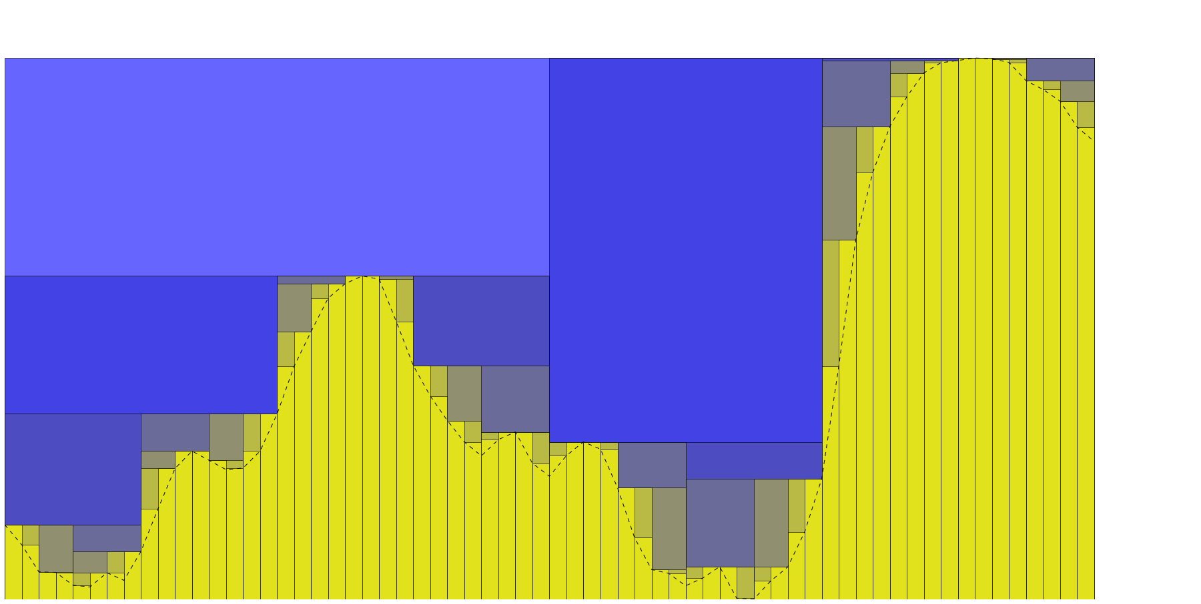
Maximum Mipmap (2D)

Slide 34
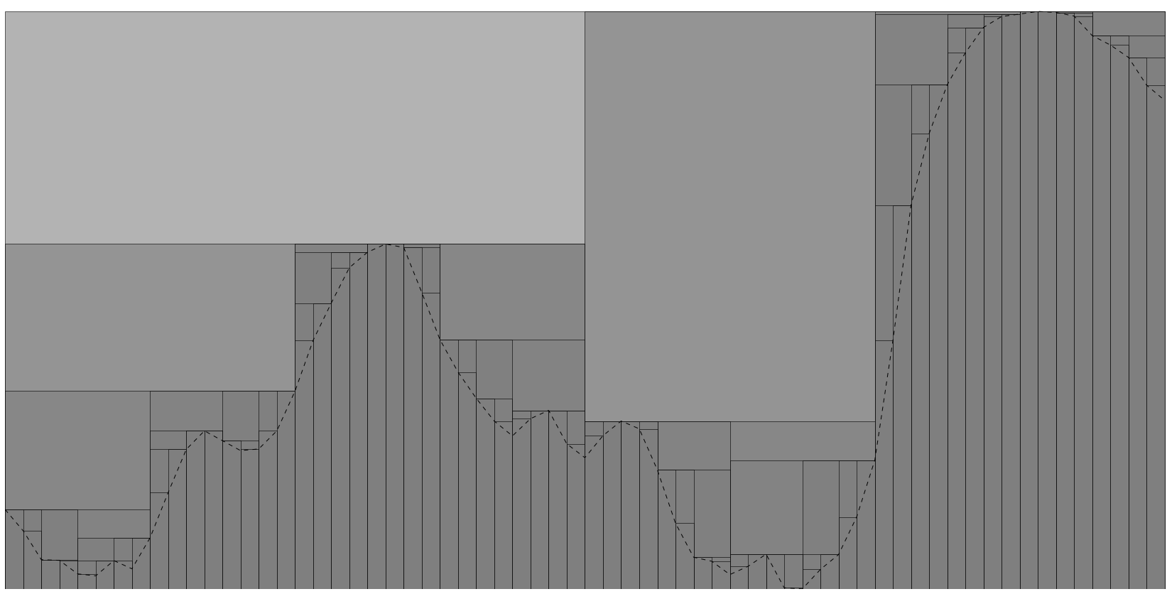
Maximum Mipmap (2D)

Slide 35
Maximum Mipmap (2D)

Slide 36
Maximum Mipmap (2D)

Slide 37
Maximum Mipmap (2D)

Slide 38
Maximum Mipmap (2D)

Slide 39
Maximum Mipmap (2D)

Slide 40
Maximum Mipmap (2D)

Slide 41

Maximum Mipmap (2D)

Slide 42
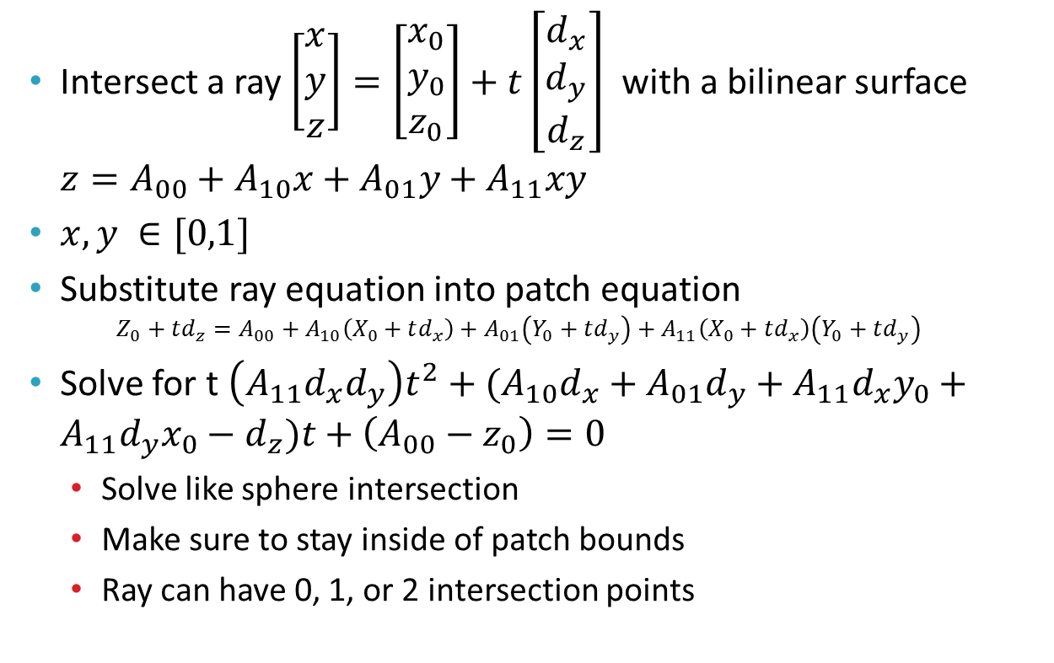
Bilinear Patch Intersection
Intersect a ray $\left[\begin{aligned}x \\ y \\ z\end{aligned}\right]=\left[\begin{aligned}x_{0} \\ y_{0} \\ z_{0}\end{aligned}\right]+t\left[\begin{aligned}d_{x} \\ d_{y} \\ d_{z}\end{aligned}\right]$ with a bilinear surface $z=A_{00}+A_{10}x+A_{01}y+A_{11}xy$
$x,y ∈[0,1]$
Substitute ray equation into patch equation $Z_{0}+td_{z}=A_{00}+A_{10}\left(X_{0}+td_{x}\right)+A_{01}\left(Y_{0}+td_{y}\right)+A_{11}\left(X_{0}+td_{x}\right)\left(Y_{0}+td_{y}\right)$
Solve for t $\left(A_{11}d_{x}d_{y}\right)t^{2}+(A_{10}d_{x}+A_{01}d_{y}+A_{11}d_{x}y_{0}+A_{11}d_{y}x_{0}−d_{z})t+\left(A_{00}−z_{0}\right)=0$
Solve like sphere intersection
Make sure to stay inside of patch bounds
Ray can have 0, 1, or 2 intersection points

Slide 43
Results – Maximum Mipmap
Green channel used to indicate number of steps before surface intersection
Blue channel indicates height of terrain

Slide 44
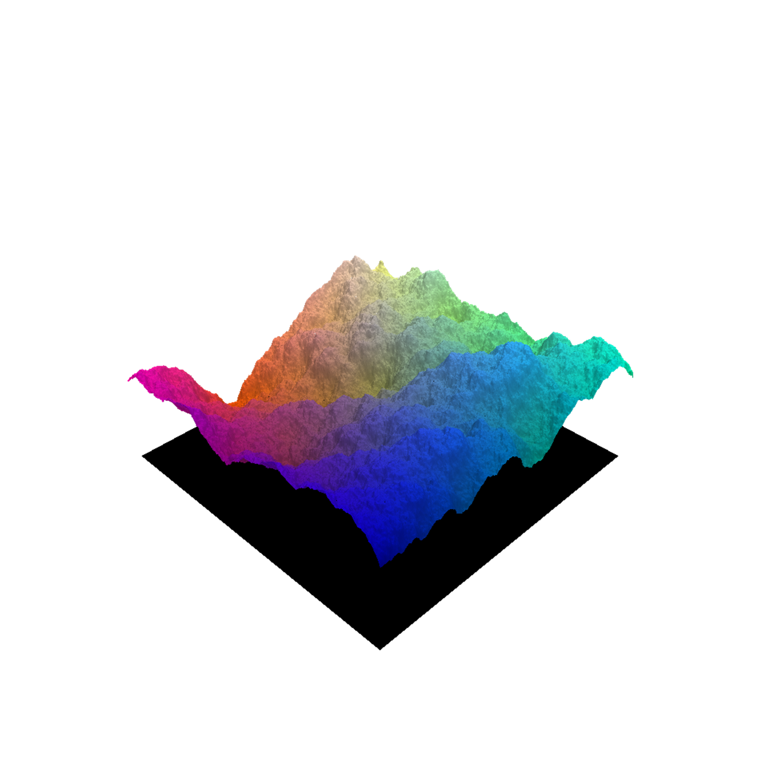
Results – Bilinear Patch Intersection
Color represents intersection position
Shading based on patch normals

Slide 45
Questions?

Slide 46
References
Schafhitzel, Tobias, Martin Falk, and Thomas Ertl. "Real-time rendering of planets with atmospheres." (2007).
O’Neil, Sean. "Accurate atmospheric scattering." GPU Gems 2 (2005): 253-268.
Dick, Christian, Jens Krüger, and Rüdiger Westermann. "GPU ray-casting for scalable terrain rendering." Proceedings of EUROGRAPHICS. Vol. 50. 2009.
Tevs, Art, Ivo Ihrke, and Hans-Peter Seidel. "Maximum mipmaps for fast, accurate, and scalable dynamic height field rendering." Proceedings of the 2008 symposium on Interactive 3D graphics and games. ACM, 2008.
http://modis.gsfc.nasa.gov/ - MODIS Texture Data

